Slide 1
AE-214 Thermodynamics
Sudarshan Kumar

Slide 2
Lecture schedule:
Slot 1: Mon 1130-1230 hrs.
Tue 0830-0930 hrs.
Thu 0930-1030 hrs.
Venue: LCC32
Course details will be uploaded on moodle

Slide 3
Course contents
Basic concepts: System boundary, surroundings, state, extensive and intensive properties, energy interactions, work and heat transfers, equilibrium, quasi-static and reversible processes, non-equilibrium and irreversible processes.
Thermodynamic laws: Zeroth law and temperature, first law and internal energy, first law applied to flow processes, second law, entropy and absolute temperature, third law and absolute entropy, thermodynamics of simple compressible systems, energy and exergy.
Applications: Closed and open systems, polytropic processes, cyclic processes, Carnot cycle; Cycle analysis: Otto cycle, Diesel cycle, Joule-Brayton cycle; ideal and real cycles, design point analysis.

Slide 4
Special topics: Elements of heat transfer and combustion, isentropic flow, flow with friction and heat transfer.
Introduction to aerospace power plants: Piston prop, turboprop, turbojet, turbofan, turbo shaft, ramjet, rockets.
Text book/references
P. K. Nag, Engineering thermodynamics, Tata McGraw Hill Co.
R. E. Sonntag, C. Borgnakke and G. J. Van Wylen, Fundamentals of Thermodynamics, 6th Ed., Wiley, 2002.
Cengel and Boles, Thermodynamics: an engineering approach, Tata McGraw Hill.
H. Cohen, G. F. C. Rogers and H. I. H. Saravanamuttoo, Gas turbine theory, 5th Ed., Pearson Education Asia, 2001.
Hill and Peterson, Mechanics and Thermodynamics of Propulsion, Addison Wesley.
J. P Holman, Heat Transfer, Tata McGraw Hill
H S Mukunda, Understanding Combustion, University Press/
Heat Tra

Slide 5
Evaluation scheme
End Semester: 50%
Mid-semester exam: 25 %
Attendance (5 % weightage for attendance greater than 95%)
Anybody getting attendance equal to or less than 95% gets Zeroooooo)
Quizzes: 20% (dates to be announced in advance, no makeup quizzes)
Mid-semester and end-semester exam: One A4 formulae sheet permitted
Assignments/homework: After each tutorial session, exercise questions to be uploaded on moodle. These questions are meant for practice.

Slide 6
Grading scheme:
Total marks obtained during the semester to be added up and scaled to 100.
The maximum marks scored (by the topper of the class) out of 100 to be converted to 100 (if the absolute marks scored is > 90) and marks of others to be normalized based on this scaling factor.
If the maximum absolute marks scored is between 80-90, then the maximum grade awarded will be AB (The marks will be scaled to 95).

Slide 7
Cut-offs after normalization:
FR<40
40<DD<45
45<CD<55
55<CC<65
65<BC<75
75<BB<85
85<AB<95
95<AA<100

Slide 8
Policy on attendance
Attendance to be recorded as per institute rules.
An early reward in the form of DX Grade for those who have attendance less than 80% (strictly).

Slide 9
Objectives of this course
Understand basics of classical thermodynamics
Laws of thermodynamics
Fundamental concepts of thermodynamics
Applications of thermodynamic principles in engineering

Slide 10
Lect-8
System boundary
Boiler
Pump
Resistance heater
Turbine
Pump
Generator
Condenser

Slide 11
Basic Thermodynamics
Defined as the “science of energy”
Originates from Greek words therme (heat) and dynamis (power)
Conversion of heat into power
Thermodynamics encompasses all aspects of energy and energy conversions.
Thermodynamics provides an understanding of the nature and degree of energy transformations.
Thermodynamic laws are fundamental laws of nature.

Slide 12
Examples:
If we would like to
heat water in a kettle.
burn some fuel in the combustion chamber of an aero engine to propel an aircraft.
cool our room on a hot humid day.
heat up our room on a cold winter night.
What is the smallest amount of electricity/fuel needed for the above ?

Slide 13
On the other hand when we burn,
some coal/gas in a power plant to generate electricity.
Petrol/Diesel in a car engine.
What is the largest energy we can get out of these efforts?
Thermodynamics allows us to answer some of these questions.

Slide 14
Macroscopic approach: Classical thermodynamics
Does not require knowledge of behavior of individual molecules
Easier and direct approach for engineering applications
Will be followed in this course
Microscopic approach: Statistical thermodynamics
Based on behavior of group of molecules
Complicated, Kinetic theory of gases

Slide 15
Continuum:
Matter is made up of atoms that are widely spaced in the gas phase.
We disregard the atomic nature of a substance and view it as a continuous, homogeneous matter with no holes, that is, a continuum.
The continuum idealization allows us to treat properties as point functions and to assume the properties vary continually in space with no jump discontinuities.

Slide 16
O₂
1 atm, 20°C
3 × 10¹⁶ molecules/mm³
VOID
Despite the large gaps between molecules, a substance can be treated as a continuum because of the very large number of molecules

Slide 17
System and Control Volumes
System: a quantity of matter in space chosen for study
It is a macroscopically identifiable collection of matter on which we focus our attention
Surroundings: mass or region that surrounds a system
Surroundings pertain to that part of the universe that is close enough to have some perceptible effect on the system
Boundary: real or imaginary surface that separates a system from its surroundings
May be fixed or movable
Universe: system and its surroundings

Slide 18
Surroundings
System
Boundary

Slide 19
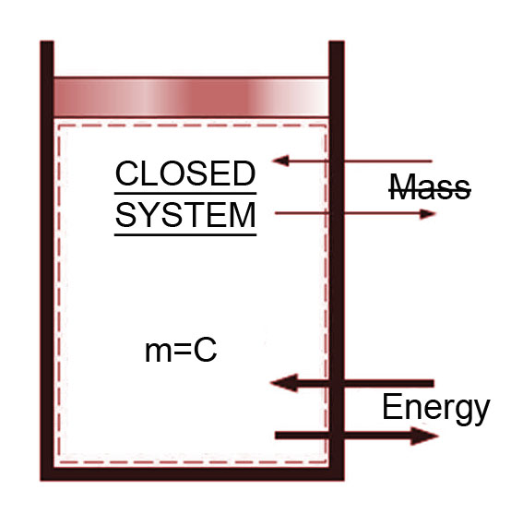
System and Control Volumes
System
Closed system: no mass transfer, energy transfer possible
Open system: also called control volume, mass and energy transfer possible
Isolated system: neither energy nor mass transfer possible

Slide 20
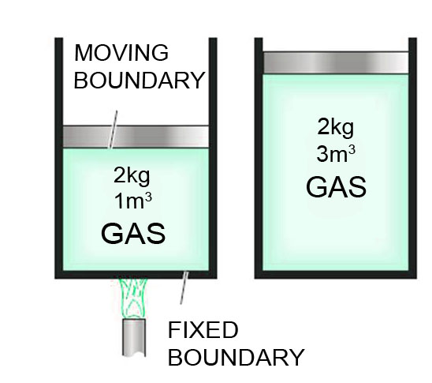
A closed system with a moving boundary

Slide 21
Real boundary
CV
(a nozzle)
Imaginary boundary
A control volume with real and imaginary boundaries

Slide 22
Moving boundary
CV
Fixed boundary
A control volume with fixed and moving boundaries

Slide 23
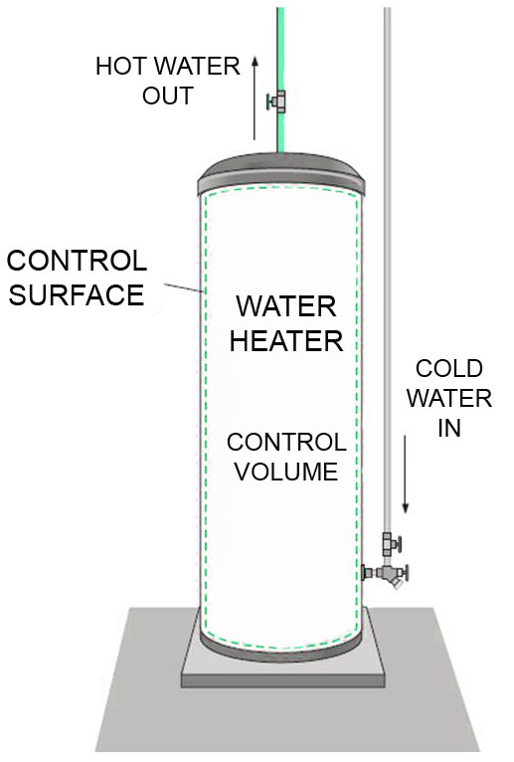
An open system (a control volume) with one inlet and one exit

